Slide 2
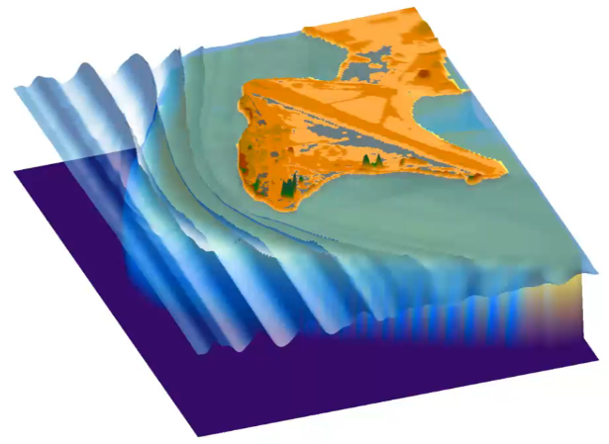
Numerical simulation of wave runup and coastal flooding in Roi-Namur.

